Slide 1







Columbia Asia Hospital Analysis
Submmited By
DIVYANSH SINGH RATHAUR

Slide 2

Problem Statement
You have been hired as a consultant data analyst by Columbia Asia Hospital. The Hospital is looking for key insights for the following objectives:
Assess the hospital's revenue generation
Insights about suitable departments for new hires
Strategies suggestions for patient discounts

Slide 3

Data Overview
Date: This column contains date and time information without specifying AM or PM. The format is DD-MM-YYYY HH:MM.
Patient ID: Each patient is assigned a unique identifier, which seems to be in the format 124-62-3289.
Patient Gender: This column records the gender of the patient, denoted by 'M' for male and 'F' for female.
Patient Age: The age of the patients is listed in years.
Patient Sat Score: It seems to represent a satisfaction score given by or for the patient. However, the scores are single-digit, and it's not clear what the scale is.
Patient First Initial: This column contains the first initial of the patient's first name.
Patient Last Name: The surname of the patient is listed in this column.

Slide 4
Data Overview
Patient Race: The racial or ethnic background of the patient is recorded here, with categories such as 'White', 'African American', 'Asian', 'Native American/Alaska Native', and 'Two or More Races'.
Patient Admin Flag: This column contains boolean values ('TRUE' or 'FALSE') which might indicate whether the patient was admitted or some other administrative flag.
Patient Wait Time: Appears to indicate the time the patient waited, possibly in minutes, before being seen or processed.
Department Referral: This column lists the department to which the patient was referred, with entries such as 'General Practice', 'Orthopedics', 'Gastroenterology', or 'None' indicating no referral.
Doctor Name: Identifies the doctor who attended each patient.
Appointment Fees: The cost charged for a doctor's consultation.
Total Bill: The overall amount billed to the patient, including all services and charges.

Slide 5


Methodology
Data Loading & Transformation:
Imported datasets into Power BI and utilized Power Query Editor for data transformation tasks such as type conversion, filtering, and data cleansing to maintain data quality and uniformity.
DAX Measure Development:
Created robust DAX measures and calculated columns to support dynamic insights, leveraging functions like SUMX, CALCULATE, conditional logic, and time intelligence functions for trend and period-based analysis.
Visualizations & Storytelling:
Built a variety of insightful visuals including bar and column charts, KPI cards, pie charts, and gauges to communicate key metrics effectively and highlight business trends.
Interactive Reporting & Dashboarding:
Enhanced user interactivity through slicers, drill-through pages, and customized visual interactions, resulting in intuitive and user-friendly dashboards tailored for deep dive analysis.

Slide 6
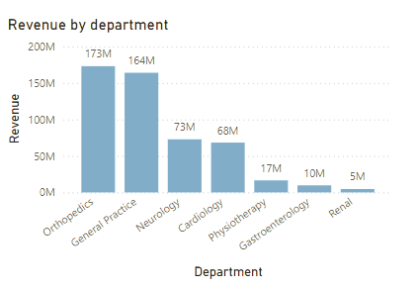
Department-Wise Revenue
Key Insights -:
The department with the highest registered revenue among all the departments is Orthopedics
with 173M.
The Department registering the lowest revenue among all the Departments is Renal with Just 5M.

Slide 7
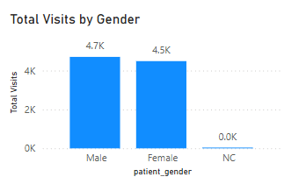
Gender-Wise Visits
Key Insights -:
The Patient Visits for the hospital with Male patients is marginally greater than the Female Patients.
The NC ( No Category ) has fewest Visits to the Hospital.

Slide 8
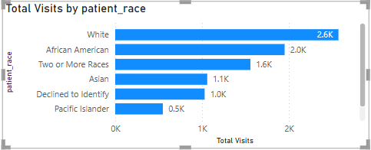
Race-wise Visits
Key Insights -:
The Hospital has most number of footfalls for the White students followed by African American and Asian Patients.
This enables an insight that the hospital has diverse and equivalent treatment for all the patients.

Slide 9
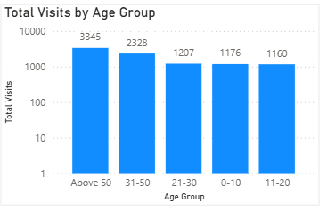
Age-Group and Visit Frequency
Key Insights -:
The Senior citizen Age-Group registered highest Visits (3345) as per the expectation as they generally suffer with chronic diseases.
The 11-20 Age group registered the least visits (1160).

Slide 10
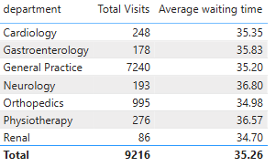
Department’s Operational Efficiency
Key Insights -:
General Practice, despite the highest footfall, achieved the lowest average wait time showcasing strong operational efficiency.
Conversely, Renal, with the least visits, reported a high 34.7-minute wait time, indicating inefficiencies.

Slide 11
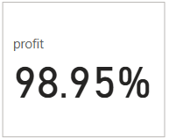
Hospital Profitability
Key Insights -:
The hospital maintains strong profitability, as revenue far exceeds appointment-related expenses.
To sustain and enhance profits, the hospital should adopt targeted marketing and discount strategies aimed at increasing patient retention and recurring visits.

Slide 12
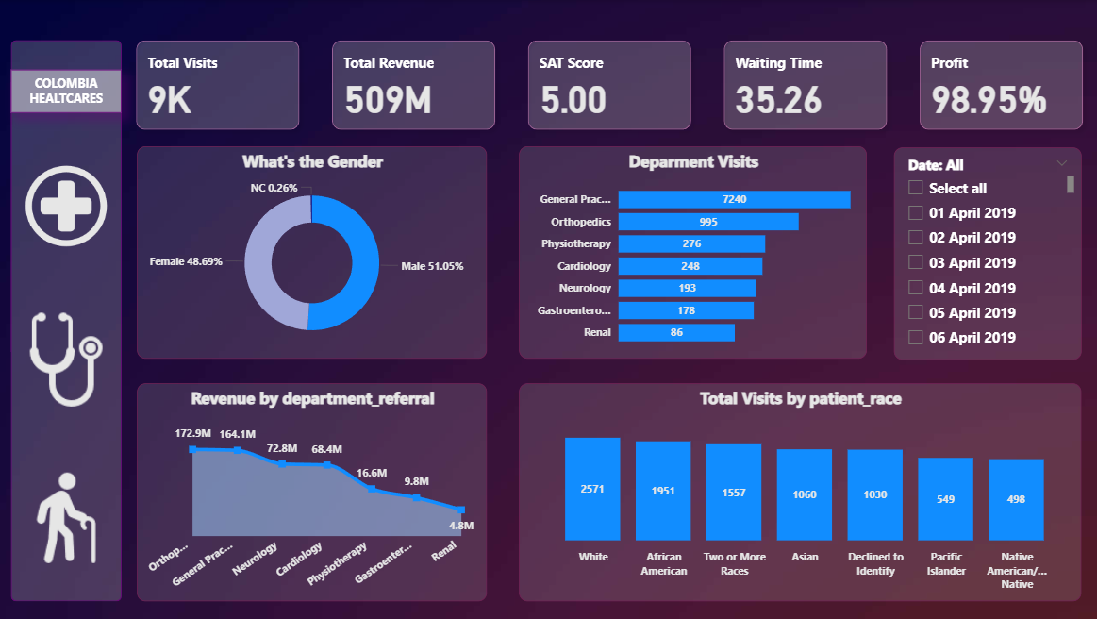

MAIN PAGE

Slide 13
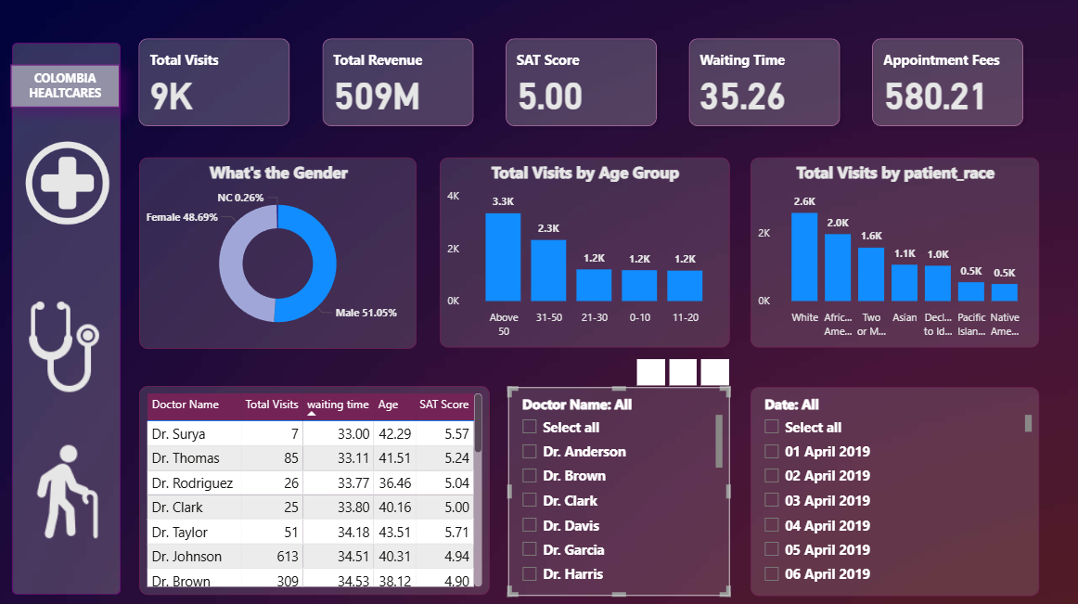

Doctor’s Page

Slide 14
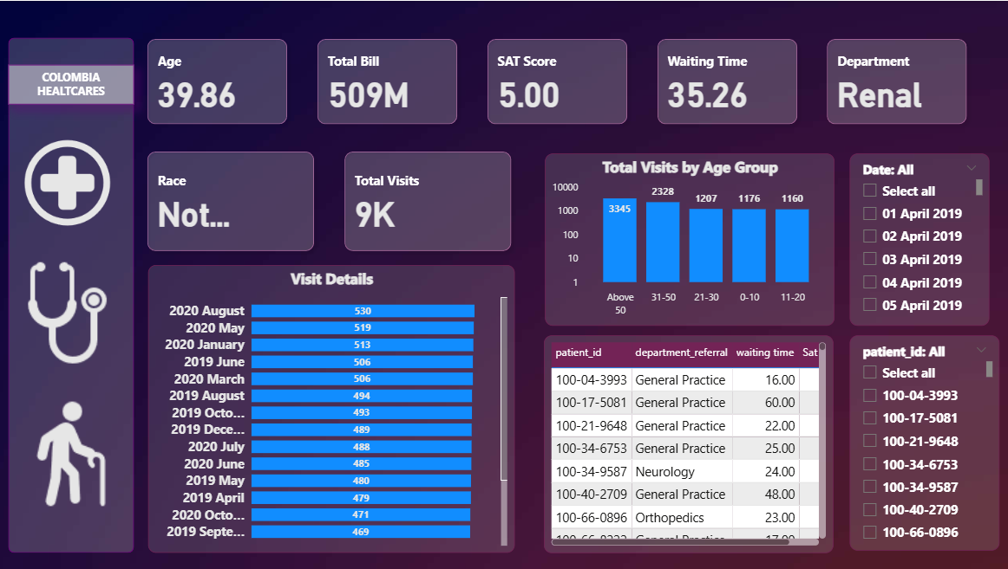

Paitent’s Page

Slide 15

Conclusion : Next Steps
Boost Efficiency in Busy Departments:
Replicate best practices from high-performing units like General Practice to improve flow across the hospital.
Improve Patient Satisfaction:
Reduce wait times in low-rated areas to directly enhance patient experience.
Use Smart Discounts for Retention:
Targeted offers can turn one-time visitors into loyal, repeat patients.
Personalize Care by Demographics:
Tailor services to high-frequency groups like senior patients for better engagement.
Invest in Staff & Data-Driven Planning:
The Hospital should hire a few staffs for the high volume departments and inefficient departments with oddly large Wait-time.

Slide 16


Thank you for your attention

